Slide 1


Photon and Neutron Open Science Cloud
The PaNOSC Project
R. Dimper – on behalf of the Consortium
30 January 2019
R Dimper – PaNOSC @ ESFRI RIs-EOSC liaison workshop – 30 January 2019

Slide 2








PaNOSC project - factsheet
Call: Horizon 2020 InfraEOSC-04
Partners: ESRF, ILL, XFEL.EU, ESS, CERIC-ERIC, ELI-DC, EGI
Description: cluster of ESFRI Photon and Neutron sources
Observers/non-funded: GÉANT, EUDAT, national RIs
Linked 3rd parties via EGI: DESY, STFC, CESNET
Status: Started 1/12/2018
Github: https://github.com/panosc-eu
Home page: https://panosc.eu
Twitter: @PaNOSC_eu #PaNOSC
Budget: 12 M€
Coordinator: ESRF
Started: 1/12/2018
Duration: 4 years
Photon and Neutron Open Science Cloud

Slide 3
PaNOSC – Why
Why – Unify the fragmented research data landscape with a common data policy framework and coherent set of services for data at the RIs and though the EOSC to give scientists better tools to fully exploit their data and facilitate the use of open data.
Opportunity: provide coherent set of services for data reduction and analysis to scientists to fully exploit their data and to promote Open Data and Open Science.

Slide 4
Why – professional data mgt and increased output
Data is our Product!
Open Data Analysed Data Digital Objects
Federated
catalogues
On-site
data reduction
Reduced Data Archived Data
RIs
Data+software
catalogues
Metadata
catalogues
Raw Data
Publications
AI
On-site
data analysis
Data mining

Slide 5
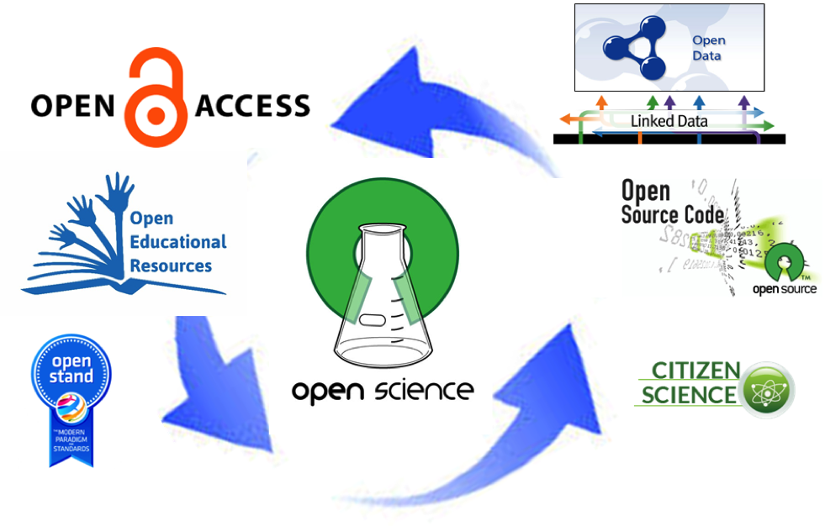
Why – to enable Open Science
“Open Science is transparent and accessible knowledge that is shared and developed through collaborative networks”
Image Source: http://www.sci-gaia.eu/osp-enab/

Slide 6
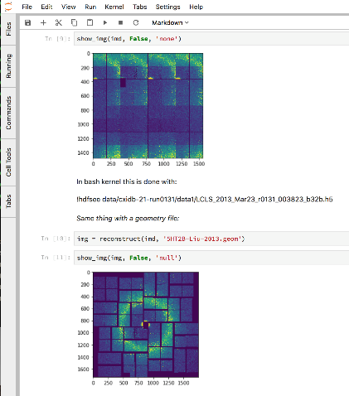
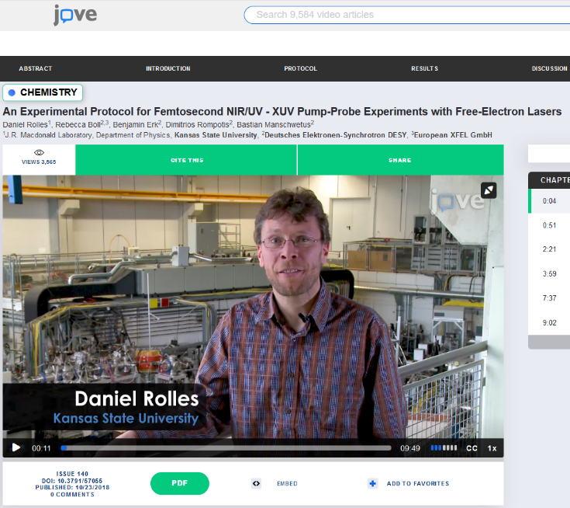
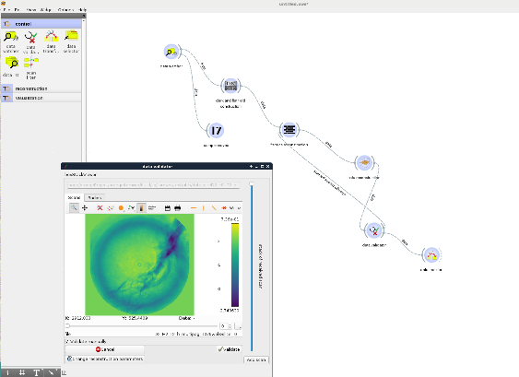
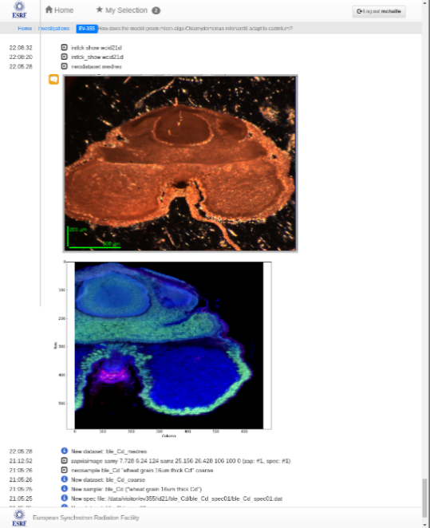
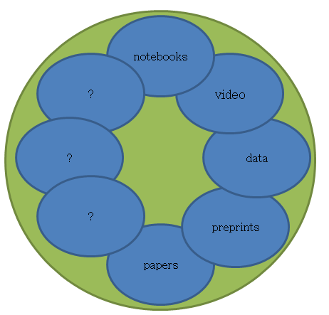
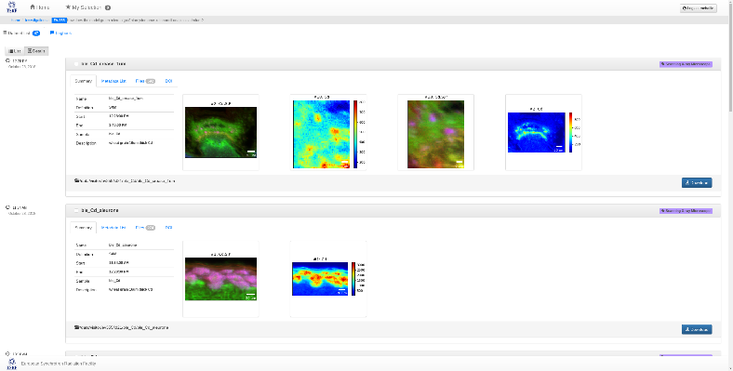
Why – to link all scientific data and output together
Image Source: http://michaelnielsen.org/blog/the-future-of-science-2/
Workflow
Logbook
Software

Slide 7
Who
Who – Photon and Neutron Open Science Cloud (PaNOSC) made up of photon and neutron RIs on the ESFRI roadmap and ERICs (CERIC-ERIC, ELI, ESRF, ESS, Eu-XFEL, ILL), pan-European e-infrastructures (EGI –as a partner-, GÉANT, EUDAT, and OpenAIRE) and national RIs and PRACE host members as observers.
Opportunity: first time synchrotrons, neutron sources, FELs, + lasers will work together with e-infrastructures to unify fragmented approach to open data management.

Slide 8
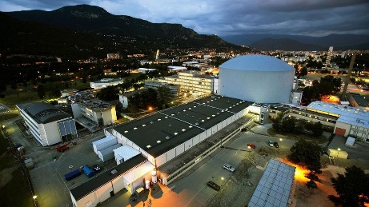
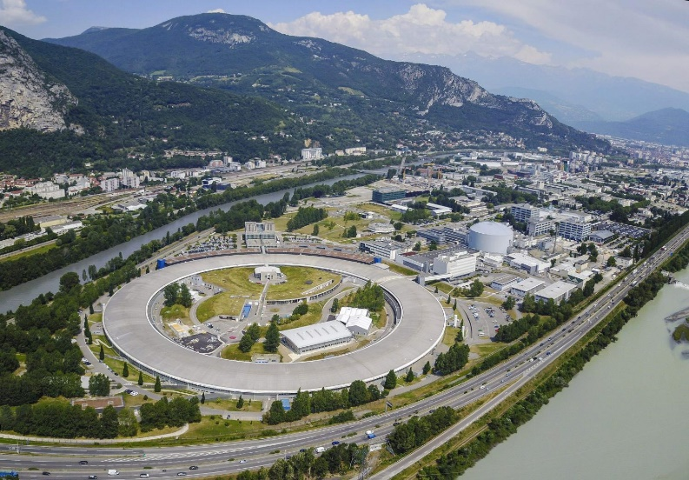
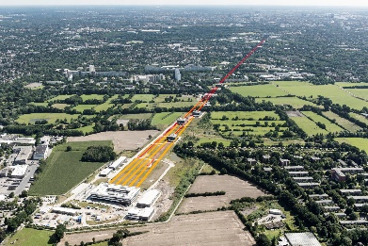



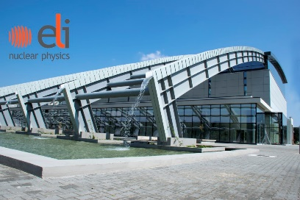

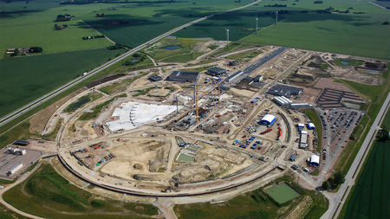

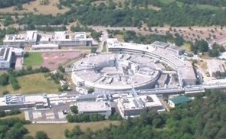

PaNOSC Partners – ESFRI projects
Photon and Neutron Open Science Cloud

Slide 9
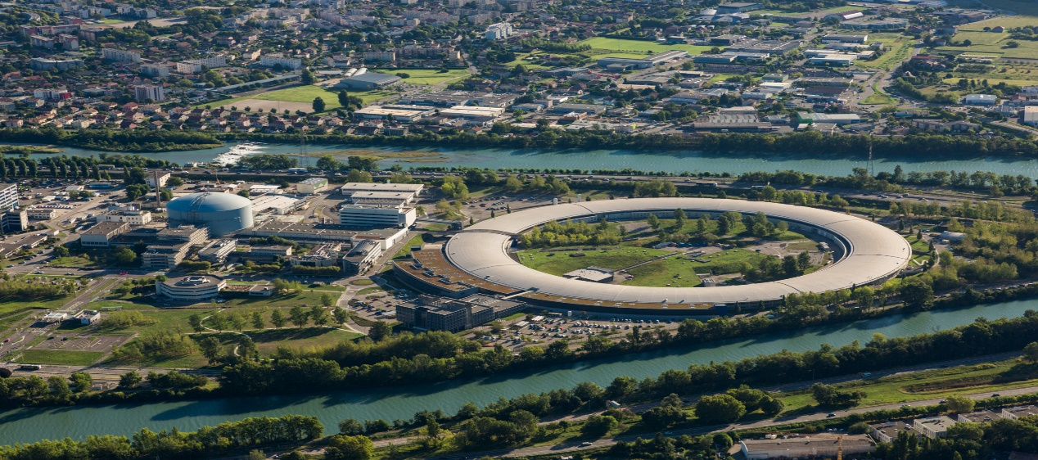
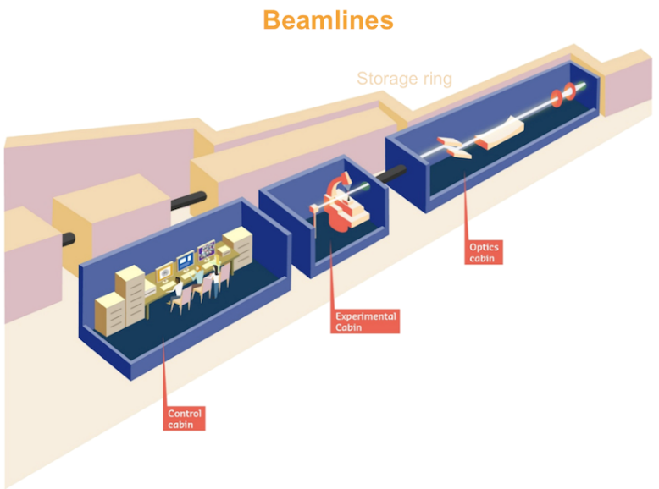
PaNOSC Partners – ESFRI projects
 | ILL | ESRF | CERIC | XFEL | ELI | ESS
Operating since | 1972 | 1994 | 2014 | 2017 | 2018 | 2022
Users/year | 1200 | 6000 | 500 | 850 | 100 | (100)
Beamlines | 40+ | 45 | 40+ | 5 | 20+ | 20+
Beamline experimental station
ESRF + ILL (Grenoble, France)

Slide 10
What
What – PaNOSC provides petabytes of curated data from thousands of applied and basic science experiments annually and the analysis software for many fields ranging from materials and life sciences to cultural heritage and palaeontology.
Opportunity: leave data at source so users can access them remotely without having to export them and promote the re-use of datasets.
Provide FAIR data to the EOSC for re-use.

Slide 11

PaNOSC – FAIR, EOSC, Open Science
How to make FAIR reality?
How to make the EOSC reality?
How to make Open Science reality?
PaNOSC will build on and help make FAIR, EOSC and Open Science become reality for the Photon and Neutron community

Slide 12
How – PaNOSC will build on the experience with Open Data policies from PanData and existing metadata catalogues, extend existing Jupyter notebook services and remote desktop, generalise simulation, link data and services to EOSC.
Opportunity: build on existing experience to fast track new RIs, enhance existing catalogues with help of experts, develop a cross-catalogue search mechanism, generalize notebooks + remote data analysis and link all this to the EOSC to build the EOSC from the bottom up through with e-infrastructures.

Slide 13

PaNOSC KPIs – 2018/2023
 | ILL | ESRF | CERIC | XFEL | ELI | ESS
Data/year 2018 | 0.2 PB | 8 PB | 1 PB | 3PB | < 1 PB | 0
Data/year 2023 | 0.6 PB | 50 PB | 15 PB | 100 PB | 10 PB | < 1 PB
Data Policy 2018 | 2011 | 2016 | 2014(3/8) | 2017 | in prog | 2017
Data Policy 2023 | 2011 | 2016 | 2019 | 2017 | 2019 | 2017
Metadata catalogue 2018 | Local | Icat | Local | myMdC | No | SciCat
Metadata catalogue 2023 | Local | Icat | Icat | myMdC | [TBD] | SciCat
Metadata definition 2018 | Nexus | Nexus | custom | myMdC | ? | Nexus
Metadata definition 2023 | Nexus | Nexus | Nexus | Nexus | [Nexus] | Nexus
DOI 2018 | yes | yes | no | yes | no | yes
DOI 2023 | yes | yes | yes | yes | yes | yes

Slide 14
PaNOSC KPIs – 2018/2023
 | ILL | ESRF | CERIC | XFEL | ELI | ESS
Open Data 2018 | Yes | Yes | No | Yes | No | No
Open Data 2023 | Yes | Yes | Yes | Yes | Yes | Yes
Data Services 2018 | Pilot | In progress | Remote | In progress | ? | In progress
Data Services 2023 | Prod | Prod | Prod | Prod | Prod | Prod
Common data API 2018 | No | No | No | No | No | No
Common data API 2023 | Yes | Yes | Yes | Yes | Yes | Yes
User training 2018 | No | No | No | No | No | No
User training 2023 | Yes | Yes | Yes | Yes | Yes | Yes

Slide 15
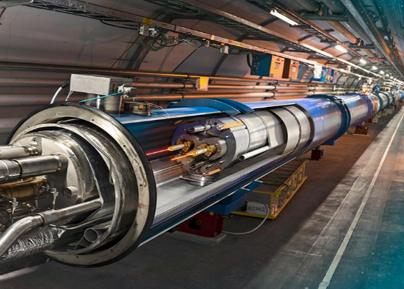
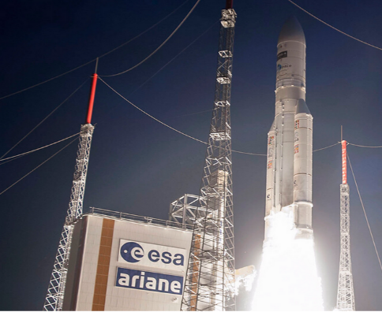

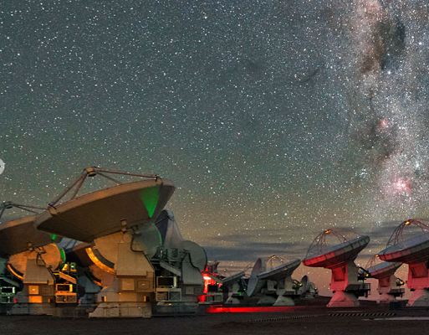


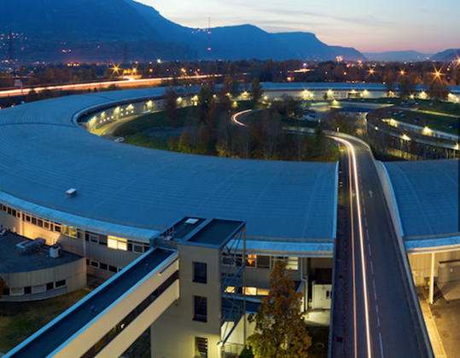
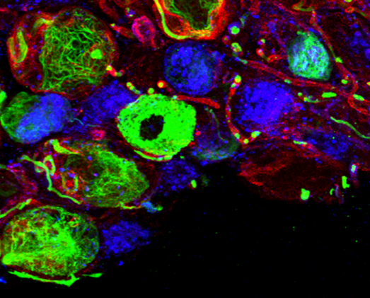
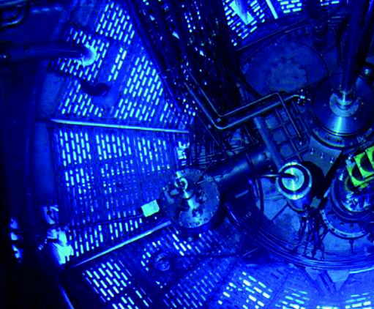
PaNOSC Stakeholders – EIROforum
= PaNOSC partner
CERN ESA EUROfusion ESO
Eu-XFEL ESRF EMBL ILL

Slide 16
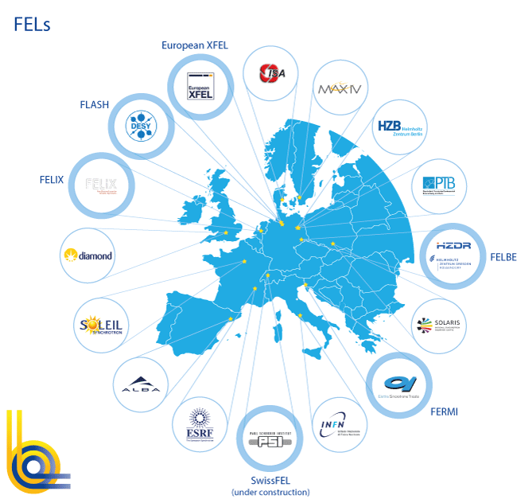
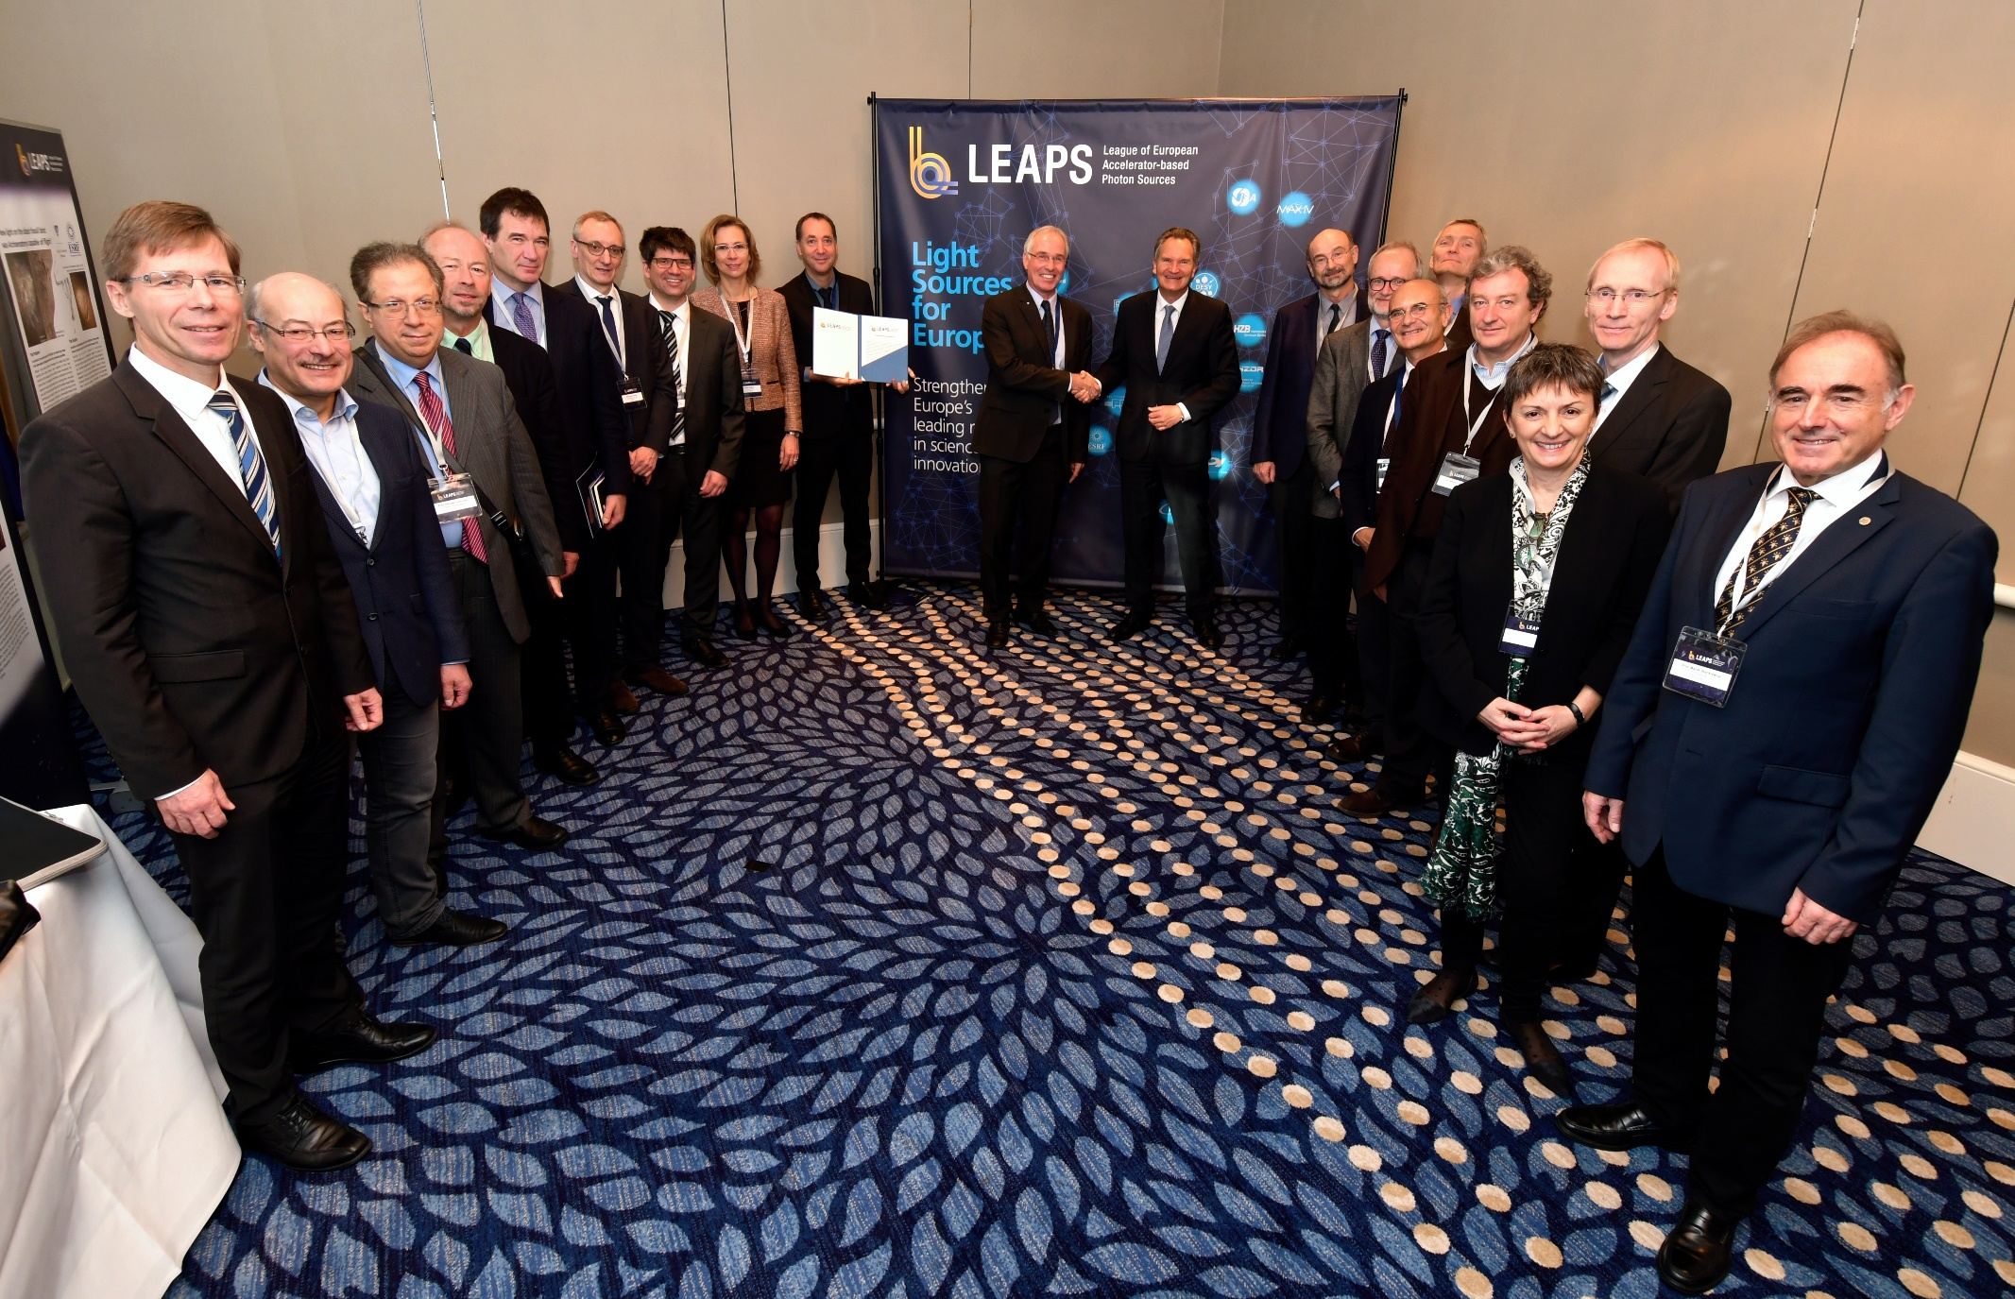
PaNOSC Stakeholders – LEAPS: Photon Science
= PaNOSC partner
LEAPS launch event in Brussels 13-Nov-2017
PaNOSC is complementary to LEAPS and preparing the LEAPS IT road map in particular for data analysis services

Slide 17
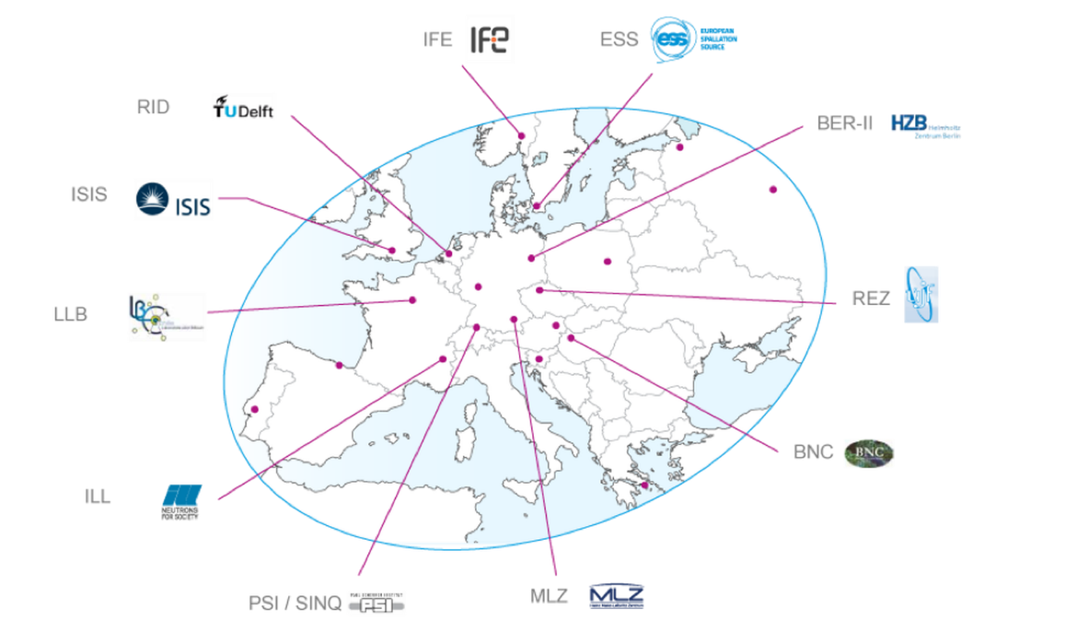
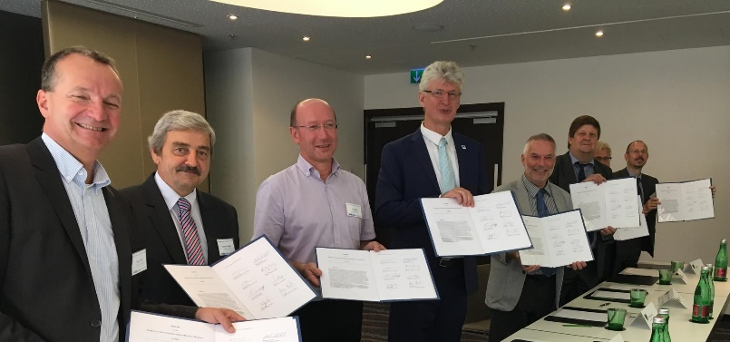
PaNOSC Stakeholders – LENS: Neutron Science
= PaNOSC partner

Slide 18
Some challenges for RIs and EOSC
FAIR data – more difficult to implement than most believe
Implementing an electronic logbook as part of the RICH metadata capture
Promote use of Jupyter notebooks and workflows to capture data analysis
Integration - services linked by a supported federated identity scheme covering the research life cycle where users access data, software, IT capacity and the expertise for performing analysis
GEANT will help PaNOSC by hosting AAI, ESFRIs to provide expertise
Hybrid model - should not compete with but rather profit from user friendliness and innovation of commercial service providers
PaNOSC will procure and integrate commercial services
Provenance, citation and use of data & software
Train users to cite DOIs and provide Open Data
Business model of how to provide services to all scientists and general public
ESFRI Photon and Neutron RIs have funding for Users who come to the source, we do not have funding for providing services for using Open Data

Slide 19
Conclusion
PaNOSC’s objectives are to:
Participate in the construction of the EOSC by linking with the e-infrastructures and other ESFRI clusters.
Make scientific data produced at Europe’s major Photon and Neutron sources fully compatible with the FAIR principles.
Generalise the adoption of open data policies, standard metadata and data stewardship from 15 photon and neutron RIs and physics institutes across Europe.
Provide innovative data services to the users of these facilities locally and the scientific community at large via the EOSC.
Increase the impact of RIs by ensuring data from user experiments can be used beyond the initial scope.
Share the outcomes with the national RIs who are observers in the proposal and the community at large to promote the adoption of FAIR data principles, data stewardship and the EOSC.

